Slide 1
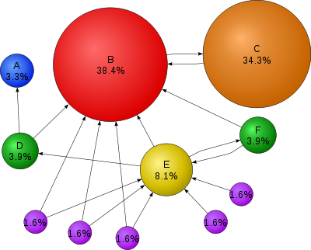
PageRank
PAGE RANK (determines the importance of webpages based on link structure)
Solves a complex system of score equations
PageRank is a probability distribution used to represent the likelihood that a person randomly clicking on links will arrive at any particular page.
Uses random walk (http://en.wikipedia.org/wiki/Random_walk) to determine page importance; you can check your page rank using: http://www.prchecker.info/check_page_rank.php
What do we cover in COSC 4335?
http://en.wikipedia.org/wiki/PageRank (Wikipedia Page)
Székely Endre Presentation (in part) (follows)
Gleich’s Stanford University 2009 PhD Dissertation Defense (only additional reading): http://www.slideshare.net/dgleich/gleich-2009defense
Also see: http://infolab.stanford.edu/~backrub/google.html (original PageRank paper)

Slide 2

PageRank’s Surfer Model
Follow edges uniformly with probability α, and
Randomly jump to any page with probability 1-α—we’ll assume everywhere is equally likely
Using this Surfer Model for a given Web structure PageRank obtains a probability distribution; for example:
“The places we find the surfer most often are important pages”

Slide 3
Google and the Page Rank Algorithm

Slide 4
A stochastic matrix (also called a Markov matrix or transition probability matrix) is a square matrix used to describe the transitions of a Markov chain.
Each column sums to 1 (for column-stochastic, as used in PageRank).
Or each row sums to 1 (for row-stochastic, common in Markov chains).
All entries are non-negative (probabilities).

Slide 5
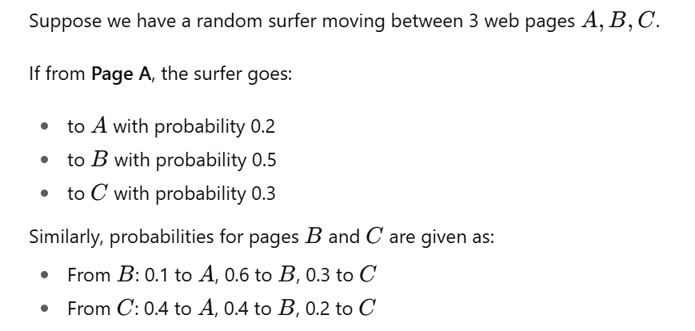
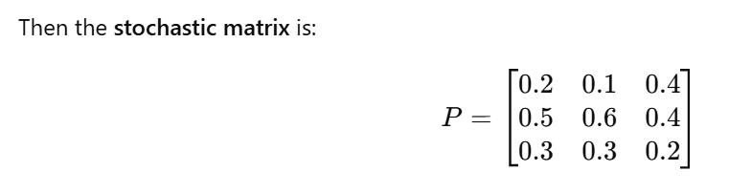

Slide 6
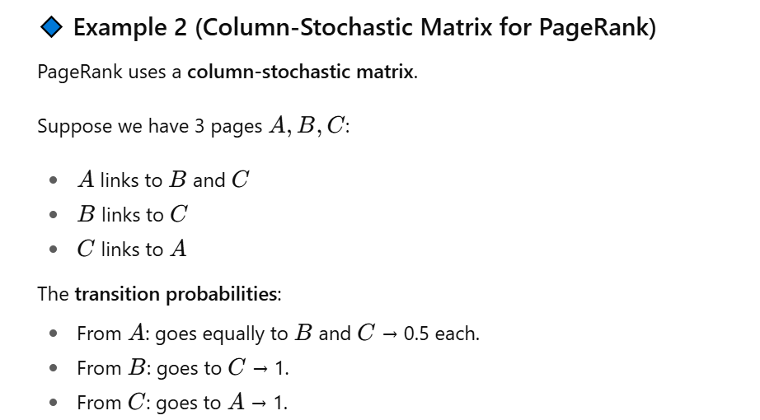
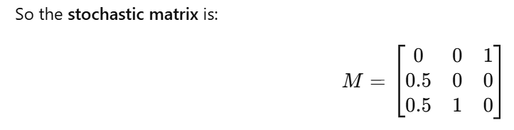

Slide 7
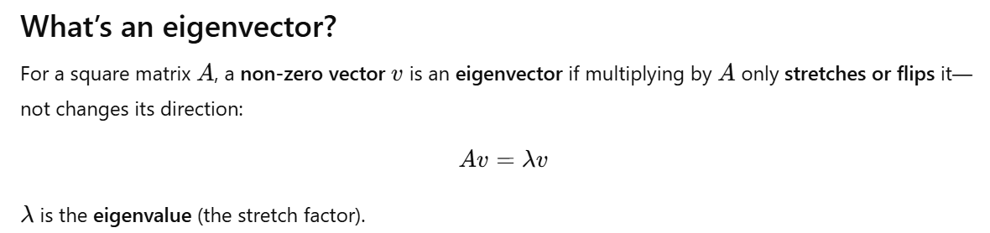

Slide 8
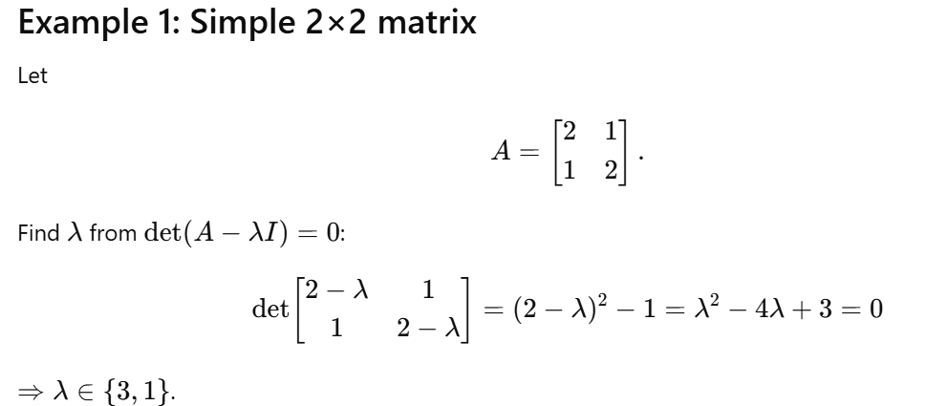

Slide 9
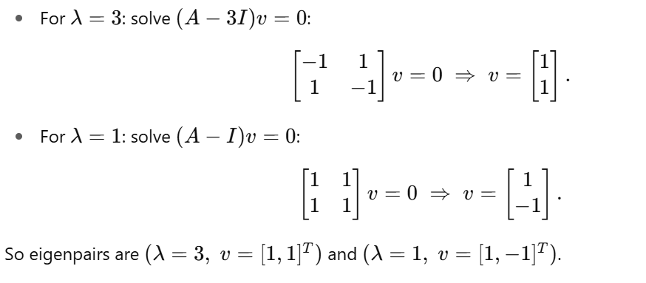

Slide 10
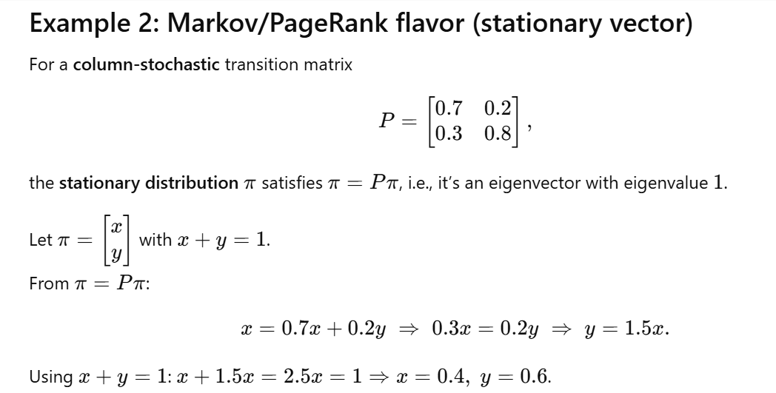
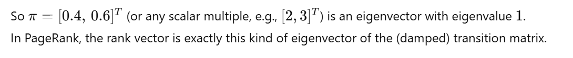

Slide 11
Overview
Few words about Google
What is PageRank™ ?
The Random Surfer Model
Characteristics of PageRank™
Computation of PageRank™
Implementation of PageRank in the Google Search Engine
The effect of different factors on the PageRank™ values
Tips for raising your website’s PageRank™ value (NEW)

Slide 12
PageRank™ - Introduction
The heart of Google’s searching software is PageRank™, a system for ranking web pages developed by Larry Page and Sergey Brin at Stanford University

Slide 13
PageRank™ - Introduction
Essentially, Google interprets a link from page A to page B as a vote, by page A, for page B.
BUT these votes doesn’t weigh the same, because Google also analyzes the page that casts the vote.

Slide 14
The original PageRank™ algorithm
PR(A) = (1-d) + d (PR(T1)/C(T1) + ... + +PR(Tn)/C(Tn))
Where:
PR(A) is the PageRank of page A,
PR(Ti) is the PageRank of pages Ti which link to page A,
C(Ti) is the number of outbound links on page Ti d is a damping factor which can be set between 0 and 1.
damping factor: the probability that a user will continue clicking on links (following the hyperlink structure) rather than randomly jump to a new page. It's a value between 0 and 1, and typically set to 0.85.

Slide 15
PageRank™ algorithm
It’s obvious that the PageRank™ algorithm does not rank the whole website, but it’s determined for each page individually. Furthermore, the PageRank™ of page A is recursively defined by the PageRank™ of those pages which link to page A

Slide 16
PR(T1)/C(T1) + ... + PR(Tn)/C(Tn)
The PageRank™ of pages Ti which link to page A does not influence the PageRank™ of page A uniformly.
The PageRank™ of a page T is always weighted by the number of outbound links C(T) on page T.
Which means that the more outbound links a page T has, the less will page A benefit from a link to it on page T.

Slide 17
PR(T1)/C(T1) + ... + PR(Tn)/C(Tn)
The weighted PageRank™ of pages Ti is then added up. The outcome of this is that an additional inbound link for page A will always increase page A's PageRank™.

Slide 18
PR(A) = (1-d) + d * (PR(T1)/C(T1) + ... + PR(Tn)/C(Tn))
After all, the sum of the weighted PageRanks of all pages Ti is multiplied with a damping factor d which can be set between 0 and 1. Thereby, the extend of PageRank benefit for a page by another page linking to it is reduced.

Slide 19
The Random Surfer Model
PageRank™ is considered as a model of user behaviour, where a surfer clicks on links at random with no regard towards content.
The random surfer visits a web page with a certain probability which derives from the page's PageRank.
The probability that the random surfer clicks on one link is solely given by the number of links on that page.
This is why one page's PageRank is not completely passed on to a page it links to, but is devided by the number of links on the page.

Slide 20
The Random Surfer Model (2)
So, the probability for the random surfer reaching one page is the sum of probabilities for the random surfer following links to this page.
This probability is reduced by the damping factor d. The justification within the Random Surfer Model, therefore, is that the surfer does not click on an infinite number of links, but gets bored sometimes and jumps to another page at random.

Slide 21
The damping factor d
The probability for the random surfer not stopping to click on links is given by the damping factor d, which depends on probability therefore, is set between 0 and 1
The higher d is, the more likely will the random surfer keep clicking links. Since the surfer jumps to another page at random after he stopped clicking links, the probability therefore is implemented as a constant (1-d) into the algorithm.
Regardless of inbound links, the probability for the random surfer jumping to a page is always (1-d), so a page has always a minimum PageRank.

Slide 22
A Different Notation of the PageRank Algorithm
PR(A) = (1-d) / N + d (PR(T1)/C(T1) + ... + PR(Tn)/C(Tn))
where N is the total number of all pages on the web.
Regarding the Random Surfer Model, the second version's PageRank™ of a page is the actual probability for a surfer reaching that page after clicking on many links. The PageRanks then form a probability distribution over web pages, so the sum of all pages' PageRanks will be one.

Slide 23
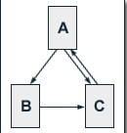
The Characteristics of PageRank™
We regard a small web consisting of three pages A, B and C, whereby page A links to the pages B and C, page B links to page C and page C links to page A. According to Page and Brin, the damping factor d is usually set to 0.85, but to keep the calculation simple we set it to 0.5.
PR(A) = 0.5 + 0.5 PR(C)
PR(B) = 0.5 + 0.5 (PR(A) / 2)
PR(C) = 0.5 + 0.5 (PR(A) / 2 + PR(B))
We get the following PageRank™ values for the single pages:
PR(A) = 14/13 = 1.07692308
PR(B) = 10/13 = 0.76923077
PR(C) = 15/13 = 1.15384615
The sum of all pages' PageRanks is 3 and thus equals the total number of web pages.

Slide 24
The Iterative Computation of PageRank
For the simple three-page example it is easy to solve the according equation system to determine PageRank values. In practice, the web consists of billions of documents and it is not possible to find a solution by inspection.
Because of the size of the actual web, the Google search engine uses an approximative, iterative computation of PageRank values. This means that each page is assigned an initial starting value and the PageRanks of all pages are then calculated in several computation circles based on the equations determined by the PageRank algorithm. The iterative calculation shall again be illustrated by the three-page example, whereby each page is assigned a starting PageRank value of 1.

Slide 25
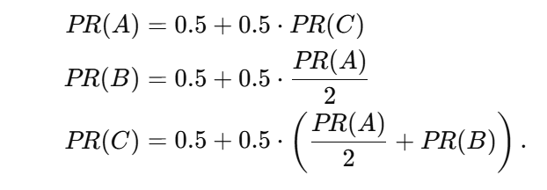

Slide 26
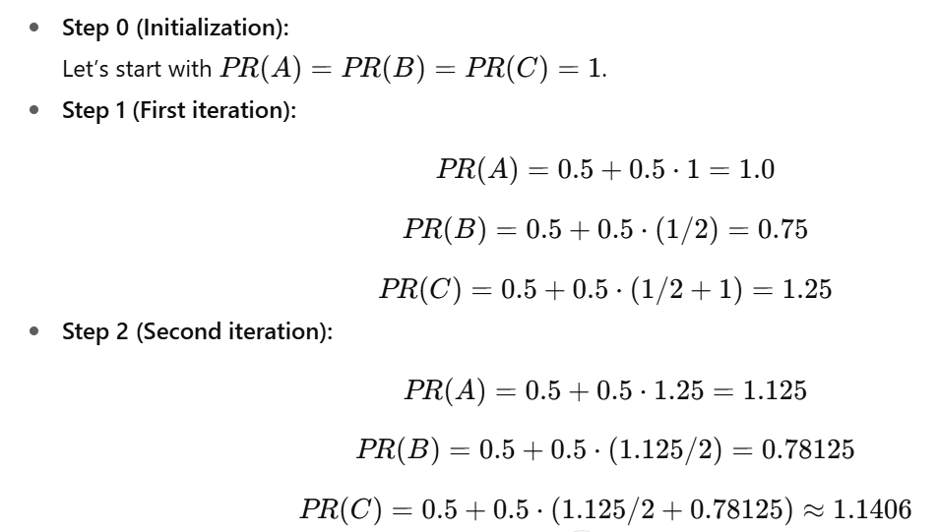

Slide 27
The Iterative Computation of PageRank (example)
Iteration PR(A) PR(B) PR(C)
0 1 1 1
1 1 0.75 1.125
2 1.0625 0.765625 1.1484375
3 1.07421875 0.76855469 1.15283203
4 1.07641602 0.76910400 1.15365601
5 1.07682800 0.76920700 1.15381050
6 1.07690525 0.76922631 1.15383947
7 1.07691973 0.76922993 1.15384490
8 1.07692245 0.76923061 1.15384592
9 1.07692296 0.76923074 1.15384611
10 1.07692305 0.76923076 1.15384615
11 1.07692307 0.76923077 1.15384615
12 1.07692308 0.76923077 1.15384615

Slide 28
The Iterative Computation of PageRank™ (3)
We get a good approximation of the real PageRank values after only a few iterations. According to publications of Lawrence Page and Sergey Brin, about 100 iterations are necessary to get a good approximation of the PageRank values of the whole web.
The sum of all pages' PageRanks still converges to the total number of web pages. So the average PageRank of a web page is 1.

Slide 29
Example Webstructure

Slide 30
The Implementation of PageRank in the Google Search Engine
Skip!
Initially, the ranking of web pages by the Google search engine was determined by three factors:
Page specific factors
Anchor text of inbound links
PageRank
Page specific factors are, besides the body text, for instance the content of the title tag or the URL of the document.
Since the publications of Page and Brin more factors have joined the ranking methods of the Google search engine.

Slide 31
The Implementation of PageRank in the Google Search Engine (2)
In order to provide search results, Google computes an IR score out of page specific factors and the anchor text of inbound links of a page, which is weighted by position and accentuation of the search term within the document.
This way the relevance of a document for a query is determined.
The IR-score is then combined with PageRank as an indicator for the general importance of the page.
To combine the IR score with PageRank the two values are multiplied. Obviously that they cannot be added, since otherwise pages with a very high PageRank would rank high in search results even if the page is not related to the search query.

Slide 32
The Implementation of PageRank in the Google Search Engine (3)
Skip!
For queries consisting of two or more search terms, there is a far bigger influence of the content related ranking criteria, whereas the impact of PageRank is mainly visible for unspecific single word queries.
If webmasters target search phrases of two or more words it is possible for them to achieve better rankings than pages with high PageRank by means of classical search engine optimisation.

Slide 33
The Effect of Inbound Links
Skip!
each additional inbound link for a web page always increases that page's PageRank. Taking a look at the PageRank algorithm, which is given by
PR(A) = (1-d) + d (PR(T1)/C(T1) + ... + PR(Tn)/C(Tn))
one may assume that an additional inbound link from page X increases the PageRank of page A by
d × PR(X) / C(X)
where PR(X) is the PageRank of page X and C(X) is the total number of its outbound links.

Slide 34
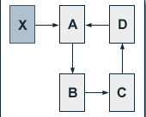
The Effect of Inbound Links (2)
Skip!
Furthermore A usually links to other pages itself. Thus, these pages get a PageRank benefit also. If these pages link back to page A, page A will have an even higher PageRank benefit from its additional inbound link.
The single effects of additional inbound links illustrated by an example:

Slide 35
The Effect of Inbound Links (3)
Skip!
We regard a website consisting of four pages A, B, C and D which are linked to each other in circle. Without external inbound links to one of these pages, each of them obviously has a PageRank of 1. We now add a page X to our example, for which we presume a constant Pagerank PR(X) of 10. Further, page X links to page A by its only outbound link. Setting the damping factor d to 0.5, we get the following equations for the PageRank values of the single pages of our site:
PR(A) = 0.5 + 0.5 (PR(X) + PR(D)) = 5.5 + 0.5 PR(D) PR(B) = 0.5 + 0.5 PR(A) PR(C) = 0.5 + 0.5 PR(B) PR(D) = 0.5 + 0.5 PR(C)
Since the total number of outbound links for each page is one, the outbound links do not need to be considered in the equations. Solving them gives us the following PageRank values:
PR(A) = 19/3 = 6.33 PR(B) = 11/3 = 3.67 PR(C) = 7/3 = 2.33 PR(D) = 5/3 = 1.67
We see that the initial effect of the additional inbound link of page A, which was given by
d × PR(X) / C(X) = 0,5 × 10 / 1 = 5
is passed on by the links on our site.

Slide 36
The Influence of the Damping Factor
Skip!
The degree of PageRank propagation from one page to another by a link is primarily determined by the damping factor d. If we set d to 0.75 we get the following equations for our above example:
PR(A) = 0.25 + 0.75 (PR(X) + PR(D)) = 7.75 + 0.75 PR(D) PR(B) = 0.25 + 0.75 PR(A) PR(C) = 0.25 + 0.75 PR(B) PR(D) = 0.25 + 0.75 PR(C)
The results gives us the following PageRank values:
PR(A) = 419/35 = 11.97 PR(B) = 323/35 = 9.23 PR(C) = 251/35 = 7.17 PR(D) = 197/35 = 5.63
First of all, we see that there is a significantly higher initial effect of additional inbound link for page A which is given by
d × PR(X) / C(X) = 0.75 × 10 / 1 = 7.5

Slide 37
The Influence of the Damping Factor (2)
Skip!
The PageRank of page A is almost twice as high at a damping factor of 0.75 than it is at a damping factor of 0.5.
At a damping factor of 0.5 the PageRank of page A is almost four times superior to the PageRank of page D, while at a damping factor of 0.75 it is only a little more than twice as high.
So, the higher the damping factor, the larger is the effect of an additional inbound link for the PageRank of the page that receives the link and the more evenly distributes PageRank over the other pages of a site.

Slide 38
Tips for raising your website’s PageRank™ value
Add new pages to your website (as many as you can)
Swap links with websites which have high PageRank™ value
Raise the number of inbound links (Advertise your website on other sites)

Slide 39
Tips for raising your website’s PageRank™ value (2)
Skip!
As you can see the sum of PageRanks is the same, unless you create new web pages
An isolated website can be considered as a mini web, so if you want to raise it’s PageRank you need to add new pages to it or you can make links to it from outside pages
The pages that refer to our (isolated) website are like the newly created pages from our point of view

Slide 40
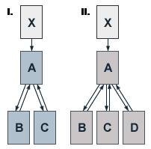
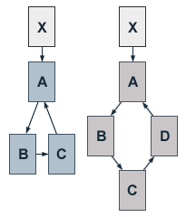
Add new pages to your website
Skip!
Right
When you add a new page to your site, be sure to link it to your front page and vice versa as it is shown on the picture
If you want to reduce your front page’s PageRank, then you can make circular references as you see on the second picture ☺
Wrong

Slide 41
The effect of additional pages
Skip!
Sub-pages PageRank of the front page
1 1.000000
2 1.428673
3 1.857347
4 2.286020
5 2.714694
10 4.858060
20 9.144795
50 22.005003
100 43.438648
250 107.739838
500 214.907135
700 300.642426
1000 429.246613

Slide 42
The effect of additional pages
Skip!
As you can see:
PageRank ≈ 1+0.428*NumberOfPages
So, if you add a web page to your website it will increase your page’s rank by ≈0.428. Of course you need to do as it is shown on the picture

Slide 43
The effect of additional pages
Skip!
The problem with this method is that if you increase your front page’s PageRank by adding additional pages, than the rank of your other pages will go down
The next method will correct this problem

Slide 44
Swap links with websites which have high PageRank™ value
Skip!
The easiest way to do this is to make a page with high PageRank and link it to your front page (but take care to not to be punished by Google with a PageRank=0 value ☺)
You can get a higher PageRank if you link your front page the outside’s sub-pages

Slide 45
Example
Skip!
Your page’s PageRank
Your page
2.520614
0 1 1 1 1 1 0 0 0
1 0 0 0 0 0 0 0 0
1 0 0 0 0 0 0 0 0
1 0 0 0 0 0 0 0 0
1 0 0 0 0 0 0 0 0
1 0 0 0 0 0 1 1 1
0 0 0 0 0 1 0 0 0
0 0 0 0 0 1 0 0 0
0 0 0 0 0 1 0 0 0
3.267607
0 1 1 1 1 1 0 0 0
1 0 0 0 0 0 0 0 0
1 0 0 0 0 0 0 0 0
1 0 0 0 0 0 0 0 0
1 0 0 0 0 0 0 0 0
1 0 0 0 0 0 1 1 1
1 0 0 0 0 1 0 0 0
1 0 0 0 0 1 0 0 0
1 0 0 0 0 1 0 0 0
A page from the web which links to your page

Slide 46
Advantages of the Inbound Links
Skip!
The PageRank of your page is calculated by adding the PageRanks of the other pages which link to your page, so it doesn’t matter if the ranks are low, because they will still raise your page’s PageRank

Slide 47
Conclusion
Skip!
The best for raising the PageRank is to combine these two methods by using them together
We saw that if you have circle references in your website, then it will reduce your front page’s PageRank
For better understanding, a couple examples and an application is attached to this presentation

Slide 48
References
http://pr.efactory.de
http://www.google.com/technology/

